Slide 1
Paper written by
George Karypis, Eui-Hong (Sam) Han, Vipin Kumar, and appeared in IEEE Computer, 1999
CHAMELEON: A Hierarchical Clustering Algorithm Using Dynamic Modeling
Presenter: P.Krishna Reddy

Slide 2
Clustering
Clustering in data mining is a discovery process that groups a set of data such that the intra-cluster similarity is maximized and the inter-cluster similarity is minimized. Existing clustering algorithms, such as K-means, PAM,
CLARANS, DBSCAN, CURE, and ROCK are designed to find clusters that fit some static models.
Can breakdown
  if the choice of parameters in the static model is incorrect with respect to the data set being clustered
  if the model is not adequate to capture the characteristics of clusters.
  when the data consists of clusters that are of diverse shapes, densities, and sizes.

Slide 3
Existing algorithms
BIRCH (1996): uses CF-tree and incrementally adjusts the quality of sub-clusters
CURE (1998): selects well-scattered points from the cluster and then shrinks them towards the center of the cluster by a specified fraction
ROCK (1999) : Agglomerative algorithm that is suited for clustering categorical attributes.
CHAMELEON (1999): hierarchical clustering using dynamic modeling

Slide 4
BIRCH (1996)
Birch: Balanced Iterative Reducing and Clustering using Hierarchies, by Zhang, Ramakrishnan, Livny (SIGMOD’96)
Incrementally construct a CF (Clustering Feature) tree, a hierarchical data structure for multiphase clustering
  Phase 1: scan DB to build an initial in-memory CF tree (a multi-level compression of the data that tries to preserve the inherent clustering structure of the data)
  Phase 2: use an arbitrary clustering algorithm to cluster the leaf nodes of the CF-tree
Scales linearly: finds a good clustering with a single scan and improves the quality with a few additional scans
Weakness: handles only numeric data, and sensitive to the order of the data record.

Slide 5

Clustering Feature Vector
Clustering Feature: CF = (N, LS, SS)
N: Number of data points
LS: ∑^{N}_{i=1}=X_{i}
SS: ∑^{N}_{i=1}=X_{i}²
CF = (5, (16,30),(54,190))
(3,4)
(2,6)
(4,5)
(4,7)
(3,8)

Slide 6
CF Tree
Root
B = 7
L = 6
CF₁
CF₂
CF₃
CF₆
child₁
child₂
child₃
child₆
Non-leaf node
CF₁
CF₂
CF₃
CF₅
child₁
child₂
child₃
child₅
Leaf node
Leaf node
prev
CF₁
CF₂
CF₆
next
prev
CF₁
CF₂
CF₄
next

Slide 7
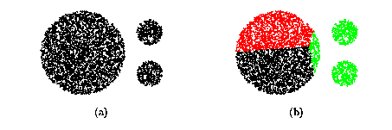
CURE (Clustering Using REpresentatives )
CURE: proposed by Guha, Rastogi & Shim, 1998
  Stops the creation of a cluster hierarchy if a level consists of k clusters
  Uses multiple representative points to evaluate the distance between clusters, adjusts well to arbitrary shaped clusters and avoids single-link effect

Slide 8
Drawbacks of Distance-Based Method
Drawbacks of square-error based clustering method
  Consider only one point as representative of a cluster
  Good only for convex shaped, similar size and density, and if k can be reasonably estimated
In CURE
  the distance between two sub-clusters is the smallest pair-wise distance between their representative points.
  Hierarchical clustering works by merging the closest pair of sub-clusters.
  Once the clusters are merged, a new set of representative are computed for the merged cluster.
Complexity is O(n)

Slide 9
Cure: The Algorithm
  Draw random sample s.
  Partition sample to p partitions with size s/p
  Partially cluster partitions into s/pq clusters
  Eliminate outliers
    By random sampling
    If a cluster grows too slow, eliminate it.
  Cluster partial clusters.
  Label data in disk

Slide 10
Data Partitioning and Clustering
  s = 50
  p = 2
  s/p = 25
  s/pq = 5
y
y
y
x
y
y
x
x
x
x

Slide 11
Cure: Shrinking Representative Points
y
y
x
x
Shrink the multiple representative points towards the gravity center by a fraction of α.
Multiple representatives capture the shape of the cluster

Slide 12
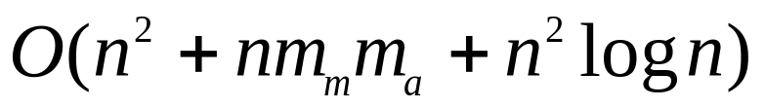

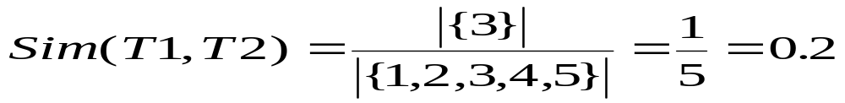
Clustering Categorical Data: ROCK
ROCK: Robust Clustering using links,
by S. Guha, R. Rastogi, K. Shim (ICDE’99).
  Use links to measure similarity/proximity
  Not distance based
  Computational complexity:
Basic ideas:
  Similarity function and neighbors:
    Let T₁ = {1,2,3}, T₂={3,4,5}

Slide 13
Rock: Algorithm
Neighbors: An objects neighbors are those objects that are considerably similar to it.
Links: The number of common neighbors for the two points.
Algorithm
  Draw random sample
  Cluster with links
  Label data in disk
{1,2,3}, {1,2,4}, {1,2,5}, {1,3,4}, {1,3,5}
{1,4,5}, {2,3,4}, {2,3,5}, {2,4,5}, {3,4,5}
{1,2,3} {1,2,4}
3

Slide 14
Drawbacks of Partitioning Techniques.
Centroid-based approaches, as typified by K means or Medoid-based methods, as typified by PAM or CLARENS
Major drawback
  they fail for data in which points in a given cluster are closer to the center of another cluster than to the center of their own cluster.

Slide 15
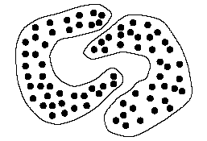
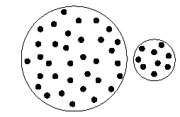
for example,
  if there is a large variation in cluster sizes.
  or when cluster shapes are convex.

Slide 16
Drawbacks of Hierarchical Techniques
Agglomerative hierarchical algorithms
CURE : a constant number of representative points are chosen to represent a cluster.
  work implicitly with the n*n similarity matrix
  merging decisions are based upon static modeling of the clusters to be merged.
  fail to take into account special characteristics of individual clusters
  make incorrect merging decisions when the underlying data does not follow the assumed model and when noise is present.
  In schemes based upon group averaging (eg. ROCK) key limitation is assume a static, user supplied inter-connectivity model, which is inflexible.

Slide 17
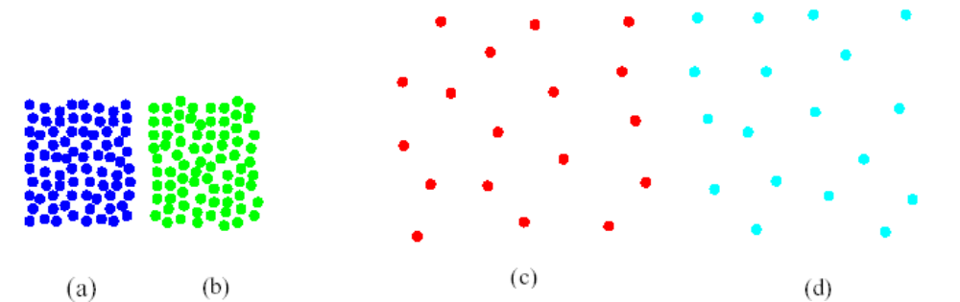
model under- or over-estimates the inter-connectivity of the data when different clusters exhibit different inter-connectivity characteristics.
CURE merges clusters (a) and (b) over merging clusters (c) and (d). But clusters (c) and (d) are better candidates for merging.
the minimum distances between the boundary points of (c) and (d) are of the same order as the average of the minimum distances of any points within these clusters to other points.

Slide 18
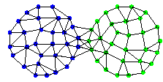

Ex. 2 (For ROCK ):-
(a) (b)
(c) (d)
ROCK selection mechanism (irrespective of the assumed model of connectivity) and the group averaging method will select pair {(c),(d)} for merging,whereas the pair{(a),(b)} is a better choice.

Slide 19
CHAMELEON : An Intro
hierarchical clustering algorithm
measures the similarity of two clusters based on a dynamic model.
operates on a sparse graph in which nodes represent data items, and weighted edges represent similarities among the data items.
uses a two phase algorithm.

Slide 20
During the first phase, CHAMELEON uses a graph partitioning algorithm to cluster the data items into a large number of relatively small sub-clusters.
During the second phase, it uses an agglomerative hierarchical clustering algorithm to find the genuine clusters by repeatedly combining together these sub-clusters.
The purpose of the first phase is to cluster the data items into a large number of sub-clusters that contain a sufficient number of items to allow dynamic modeling.
The purpose of the second phase, is to discover the genuine clusters in the dataset by using the dynamic modeling framework to merge together these sub-clusters in a hierarchical fashion.

Slide 21
The key feature of CHAMELEON’s agglomerative hierarchical clustering algorithm is that it determines the pair of most similar sub-clusters by taking into account both the inter-connectivity as well as the closeness of the clusters.
uses a novel approach to model the degree of inter-connectivity and closeness between each pair of clusters
does not depend on a static user supplied model.

Slide 22
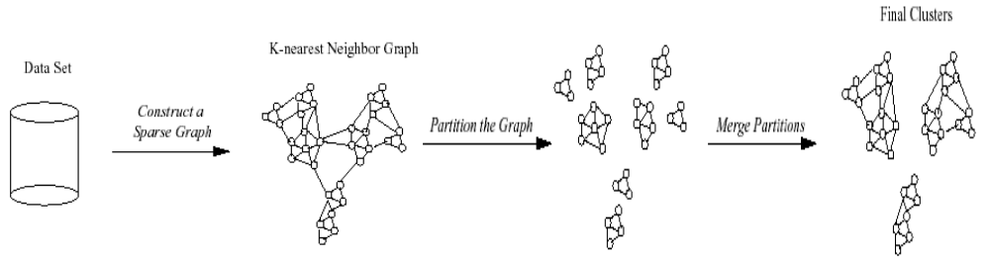
Overall Framework CHAMELEON
dynamically model the similarity between the clusters by computing their relative inter-connectivity and relative closeness.
graph partitioning is used to obtain the initial fine-grain clustering solution.

Slide 23
Modeling Data
CHAMELEON’s sparse graph representation of the data items is based on the commonly used k-nearest neighbor graph approach.
Each vertex of the k-nearest neighbor graph represents a data item, and there exists an edge between two vertices, if data items corresponding to either of the nodes is among the k-most similar data points of the data point corresponding to the other node.

Slide 24
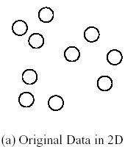
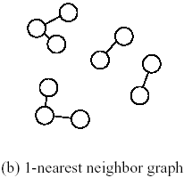
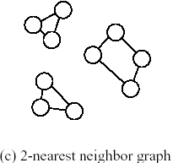
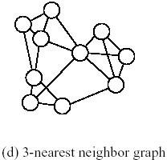
Modeling the Data
K-nearest graphs from an original data in 2D

Slide 25
Advantages of k-nearest neighbour graph
data points that are far apart are completely disconnected in the Gk
Gk captures the concept of neighborhood dynamically. In a dense region, the neighborhood is defined narrowly and in a sparse region, the neighborhood is defined more widely.
Gk captures more natural neighborhood.

Slide 26
the density of the region is recorded as the weights of the edges. As the consequence, a min-cut bisection of the graph represents the interface layer of sparse region of the graph.
Finally, Gk provides a computational advantage over a full graph in many algorithms operating on graphs, including graph partitioning and partitioning refinement algorithms.

Slide 27
Modeling Cluster Similarity
Relative Inter-Connectivity: defined as the absolute inter-connectivity between Ci and Cj normalized with respect to the internal inter-connectivity of the two clusters Ci and Cj .
absolute inter-connectivity between a pair of clusters Ci and Cj is defined to be as the sum of the weight of the edges that connect vertices in Ci to vertices in Cj.(or Edge Cut)

Slide 28
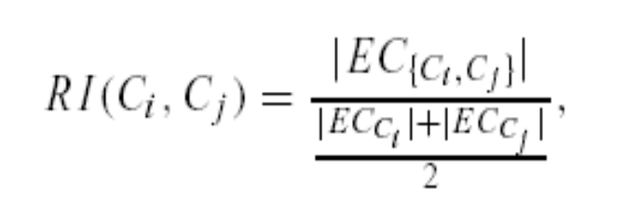
Thus the relative inter-connectivity between a pair of clusters Ci and Cj is given by
which normalizes the absolute inter-connectivity with the average internal inter-connectivity of the two clusters.
-EC{ci,cj} is the sum of the weight of the edges in edge-cut between two clusters.
-EC{ci} internal inter-connectivity of a cluster Ci. Captured by size of the mincut bisector (i.e., the weighted sum of edges that partition the graph into two roughly equal parts.)

Slide 29
Thus in Example 2 CHAMELEON correctly merges (a) and (b) over (c) and (d) since relative inter-connectivity between clusters (a) and (b) is higher than the relative inter-connectivity between clusters (c) and (d).
(a) (b)
(c) (d)

Slide 30
Relative Closeness
  defined as the absolute closeness between Ci and Cj normalized with respect to the internal closeness of the two clusters Ci and Cj .
  CHAMELEON measures the closeness of two clusters by computing the average similarity between the points in Ci that are connected to points in Cj .
  their average strength provides a very good measure of the affinity between the data items
  internal closeness of each cluster Ci can also be measured as look at all the edges connecting vertices in Ci (i.e., edges that are internal to the cluster), and compute the internal closeness of a cluster as the average weight of these edges.

Slide 31

Hence in CHAMELEON, the relative closeness between a pair of clusters Ci and Cj is computed as,
where SECCi and SECCj are the average weights of the edges that belong in the min-cut bisector of clusters Ci and Cj ,respectively.
SEC{Ci,Cj}. is the average weight of the edges that connect vertices in Ci to vertices in Cj .

Slide 32
Thus in Example 1 CHAMELEON will merge the clusters (c) and (d) over the clusters (a) and (b).
Because, the relative closeness of clusters (c) and (d) is higher than the relative closeness between clusters (a) and (b), even though the later pair of clusters have a higher absolute closeness.

Slide 33
The Algorithm
CHAMELEON finds the initial sub-clusters using a graph partitioning algorithm to partition the k-nearest neighbor graph of the data set into a large number of partitions such that the edgecut ( i.e., the sum of the weight of the edges that straddle partitions) is minimized.

Slide 34
utilizes multilevel graph partitioning algorithms to find the initial sub-clusters
  initially starts with all the points belonging to the same cluster.
  then repeatedly selects the largest sub-cluster among the current set of sub-clusters.
  This process terminates when the larger sub-cluster contains fewer than a specified number of vertices, that is referred to as MINSIZE.

Slide 35
CHAMELEON then switches to an agglomerative hierarchical clustering that combines together these small sub-clusters.
  First scheme merges only those pairs of clusters whose relative inter-connectivity and relative closeness are both above some user specified threshold TRI and TRC, respectively.

Slide 36

In this approach, CHAMELEON visits each cluster Ci ,and checks to see if any one of its adjacent clusters Cj satisfy the following two conditions:
If more than one of the adjacent clusters satisfy the above conditions, then CHAMELEON selects to merge Ci with the cluster that it is most connected to.
  i.e., it selects the cluster C j such that the absolute inter-connectivity between these two clusters is the highest.

Slide 37

Second scheme implemented in CHAMELEON uses a function to combine the relative inter-connectivity and relative closeness, and then selects to merge the pair of clusters that maximizes this function.
  select the pair of clusters Ci and Cj to merge that maximize

Slide 38
Performance Analysis
The amount of time required to compute
  K-nearest neighbor graph
  Two-phase clustering

Slide 39
Performance Analysis(cont’d)
The amount of time required to compute
  K-nearest neighbor graph
    Low-dimensional data sets = O(n log n)
    High-dimensional data sets = O(n²)

Slide 40
Performance Analysis(cont’d)
The amount of time required to compute
  Two-phase clustering
    Computing internal inter-connectivity and closeness for each cluster: O(nm)
    Selecting the most similar pair of cluster:
    O(n log n + m² log m)
  Total time = O(nm + n log n + m² log m)

Slide 41
Remarks
Does not consider the issue of scaling to large data sets that cannot fit in the main memory
CHAMELEON can discover natural clusters of different shapes and sizes
It is possible to use other algorithms instead of k-nearest neighbor graph
Different domains may require different models for capturing closeness and inter-connectivity

Slide 42
Conclusions
CHAMELEON discovers natural clusters of different shapes and sizes.
Experimental results show that Chameleon can discover natural clusters that many existing algorithms fail to find.
  CURE
  ROCK
  DBSCAN

